Slide 1
Data Structures/Big Data 1
Please turn on the silent mode of you mobile phone!
Chulalongkorn University
School of Integrated Innovation
Fall 2023
Marko Niinimaki - Marko.N@chula.ac.th

Slide 2
Welcome! Course Overview
5602201
3 credits, undergrad 2nd year.
From the syllabus: Processing data with Python, Data Structures, SQL, Interfacing SQL databases, Big Data, Text and multimedia databases, noSQL, noSQL with Python.
Basically “everything about data and databases”.
Questions for you: Programming topics covered last term: classes/objects, loops, files, lists/arrays, dictionaries, trees, graphs, sorting/searching, Big O?
Notes:
https://youtu.be/kQDxmjfkIKY?t=99

Slide 3
You need these tools
python (python3)
pip (pip3)
git
Notes:
https://youtu.be/kQDxmjfkIKY?t=99

Slide 4
What is ..
A byte
A word (computer science)
A file
A program (or executable)
A directory
Notes:
https://youtu.be/kQDxmjfkIKY?t=99

Slide 5
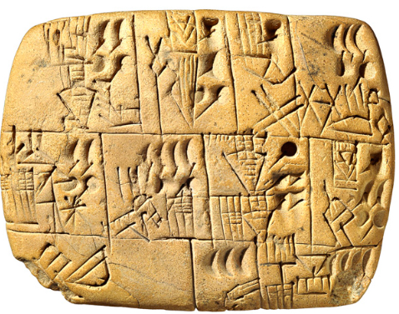
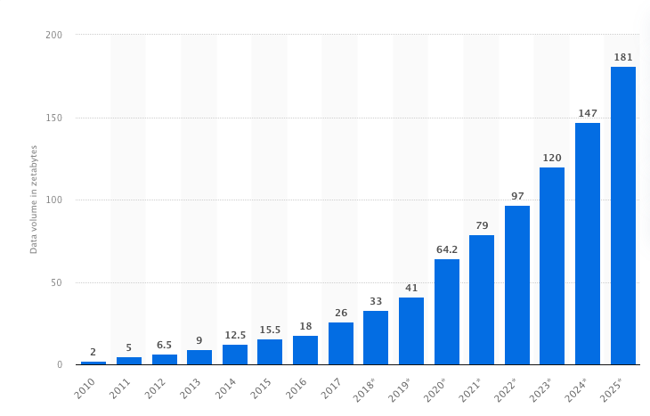
What is data? Where is it?
Created/stored/transmitted for some purpose.
We are interested in digital data, represented as bits → bytes → kilobytes → megabytes → gigabytes → terabytes → petabytes → exabytes → zettabytes (10²¹).
Statista: Volume of data/information created, captured, copied, and consumed worldwide from 2010 to 2025.
What is an algorithm?
Image credits

Slide 6
Course Practicalities 1
16 sessions, Tuesday mornings (see the syllabus).
There will be lectures and labs. Assignments (almost) every week. Some quizzes.
Main topics: Data structures with Python, text/data processing, databases, how to use them, Big Data.
Two exams: midterm, final.
Evaluation: Weekly Assignments (25%), Mid-Term Examination (35%), Final Examination (35%), Attendance (5%).
Attendance is collected in the beginning of the class. Don't be late.

Slide 7
Course Practicalities 2
Tools: Python, MySQL, MongoDB Atlas (cloud DB), Google Cloud.
The tools that we use work on Mac and Windows (who has which one?)
Course online textbook: Miller & Ranum: Problem Solving with Algorithms and Data Structures using Python https://runestone.academy/ns/books/published/pythonds3/index.html?mode=browsing
Recommended reading: Elmasri & Navathe: Fundamentals of Database Systems
Recommended watching: https://youtu.be/kQDxmjfkIKY (DS in Python 2 h)
Always read your Chula mails! Check your spam box, too. My email is Marko.N@chula.ac.th and my official meeting hours are on Mondays & Tuesdays (but you can mail me outside those hours).

Slide 8
Notes
Make sure you have Python and git on your computer and you know how to use them on the command line.
Managing data is a challenge that goes beyond technology. Why?
Is blockchain a database? Why/why not?
What is Data Science?
In your opinion, what the is most impressive use of Big Data that you have seen/used?
Next step: Python Week 1 Lab.

Slide 9
Who are the teachers?
Lecturer: Marko Niinimaki, Ph.D., background: Scientific computing, distributed systems, consulting a startup that makes mobile applications. marko.n@chula.ac.th
TA: Kitichai Chanyalikit, Msc ICT, background: Administrator, Web Designer, Graphic Designer, consulting a startup about education with psychological aspects. kitichai.c@chula.ac.th

Slide 10
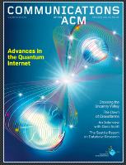
Bigger perspectives
"Demand for data scientists — also known as computer research scientists — is strong, according to the Bureau of Labor Statistics The number of data scientist jobs is expected to grow 22 percent over the next decade (2020's) — much faster than the average growth rate for all jobs." https://datascience.smu.edu/
Developers need to understand data.
https://th.jobsdb.com/th/search-jobs/developer/1 7227 jobs.
Please consider becoming an ACM student member.

Slide 11
Back slides
What are files? Examples:
http://chulademo.one/lion.png
https://www.gutenberg.org/cache/epub/11/pg11.txt
http://chulademo.one/earth.mp4
Using ChatGPT to create a Python game.
Git example:
git clone https://github.com/manzikki/chulads.git

